Slide 1




AVIAN HAZARD ADVISORY SYSTEM (AHAS)
TRAINING
Florida : California : Hawaii : Calgary : London : Bejing
www.detect-inc.com www.dronewatcher.com
Copyright 2022, DeTect, Inc, All Rights Reserved

Slide 2


OBJECTIVE
Introduce users to the AHAS system by highlighting specific capabilities, common pitfalls, and best practices
1
Copyright 2022, DeTect, Inc, All Rights Reserved

Slide 3
OVERVIEW
Outputs
  Current Conditions (current hour query)
  Forecast Conditions (>1 and ≤ 24 hrs query)
  Historical Conditions (> 24 hr query)
  Risk Summary
Common Misunderstandings
Best Practices
2
Copyright 2022, DeTect, Inc, All Rights Reserved

Slide 4
AHAS
Predicts bird movements within low level flight arena for the contiguous 48 states and Alaska
Found at https://www.usahas.com
Uses Level 2 NEXRAD data, National Weather Service (NWS) Forecasts, Soaring Bird Forecast Models, and the Bird Avoidance Model (BAM) to predict bird movements
Provides CONUS and Alaska bird strike risk for:
  IR, VR, and SR routes
  Ranges and MOA’s
  Some Military and Civilian Airfields
  Alert Areas
3
Copyright 2022, DeTect, Inc, All Rights Reserved

Slide 5
OUTPUTS
If you request information for:
  Current Hour: risk is based on observations made by the NEXRAD weather radar system, data from the Soaring Model or from the US BAM
  Less Than 24 hrs (>1 and ≤ 24 hrs query): risk is based on the Soaring Model or the US BAM. These models forecast conditions favorable for hazardous bird activity to be present
  More Than 24 hrs, or historical (> 24 hour query or past conditions): risk information comes from the current version of the US BAM
4
Copyright 2022, DeTect, Inc, All Rights Reserved

Slide 6
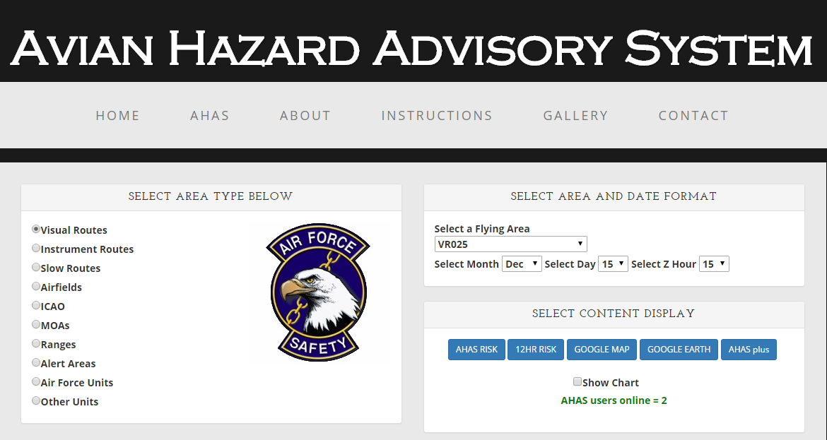
AHAS MAIN QUERY PAGE
AHAS web page tabs
AHAS immediately directs you to the query page. Check for news and other important information using the tabs at the top
AHAS allows you to select airfields based on the ICAO
To request a new unit specific page, contact the USAF BASH Team
You can also select output type
Output selection and chart option
More tabs at bottom
5
Copyright 2022, DeTect, Inc, All Rights Reserved

Slide 7
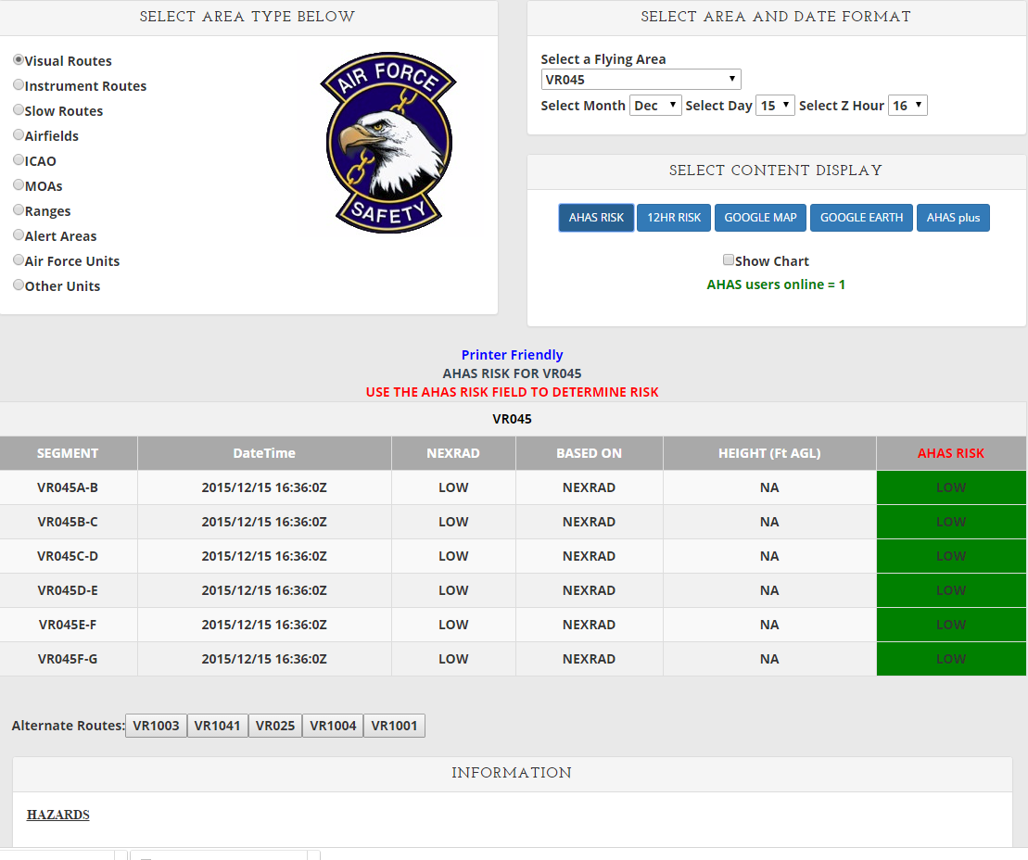
TABLE OUTPUT
1
2
3
Search Criteria: VR 045 (1, 2), current hour in Zulu (3), output choice, AHAS RISK (4)
AHAS indicates the driving model (5) for the overall risk (6), which is color coded based on risk
The results from NEXRAD will always be shown for the current hour(7)
AHAS also shows the nearest five other routes(8)
AHAS shows hazards found along the route, including dams, golf courses, and landfills(9)
The web page updates every 6 minutes when the data is updated in the database.
4
9
8
7
5
6
6
Copyright 2022, DeTect, Inc, All Rights Reserved

Slide 8
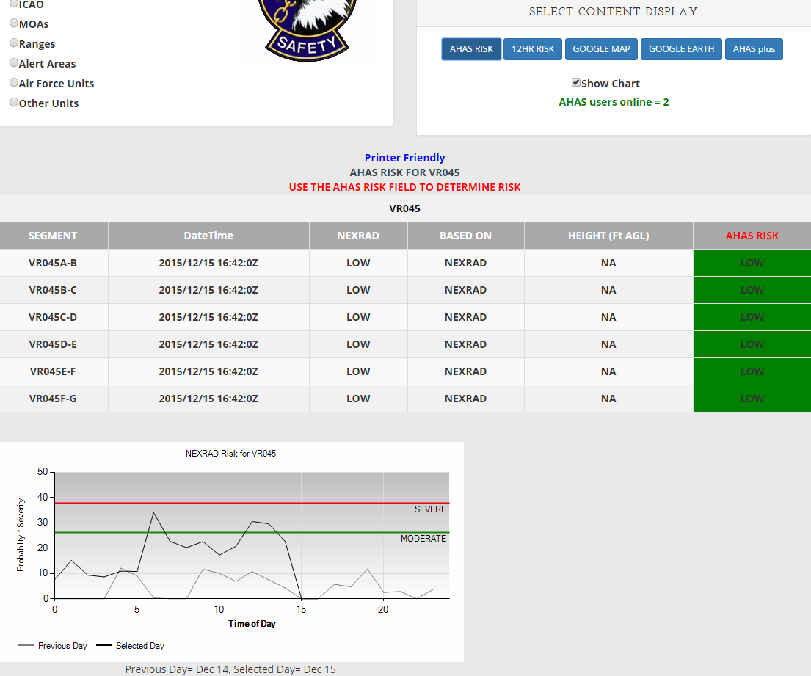
TABLE OUTPUT WITH CHART
1
Check the show chart box to display the NEXRAD data chart (1,2).
The chart shows the maximum NEXRAD risk for the selected flying area for each hour. Due to the high dynamic range of the radar reflectivity data the chart uses the log10 value of the probability * severity value seen in slide 15, “Calculating NEXRAD Risk”.
The chart shows the risk for the selected day (black line) and the previous day (gray line).
2
6
Copyright 2022, DeTect, Inc, All Rights Reserved

Slide 9
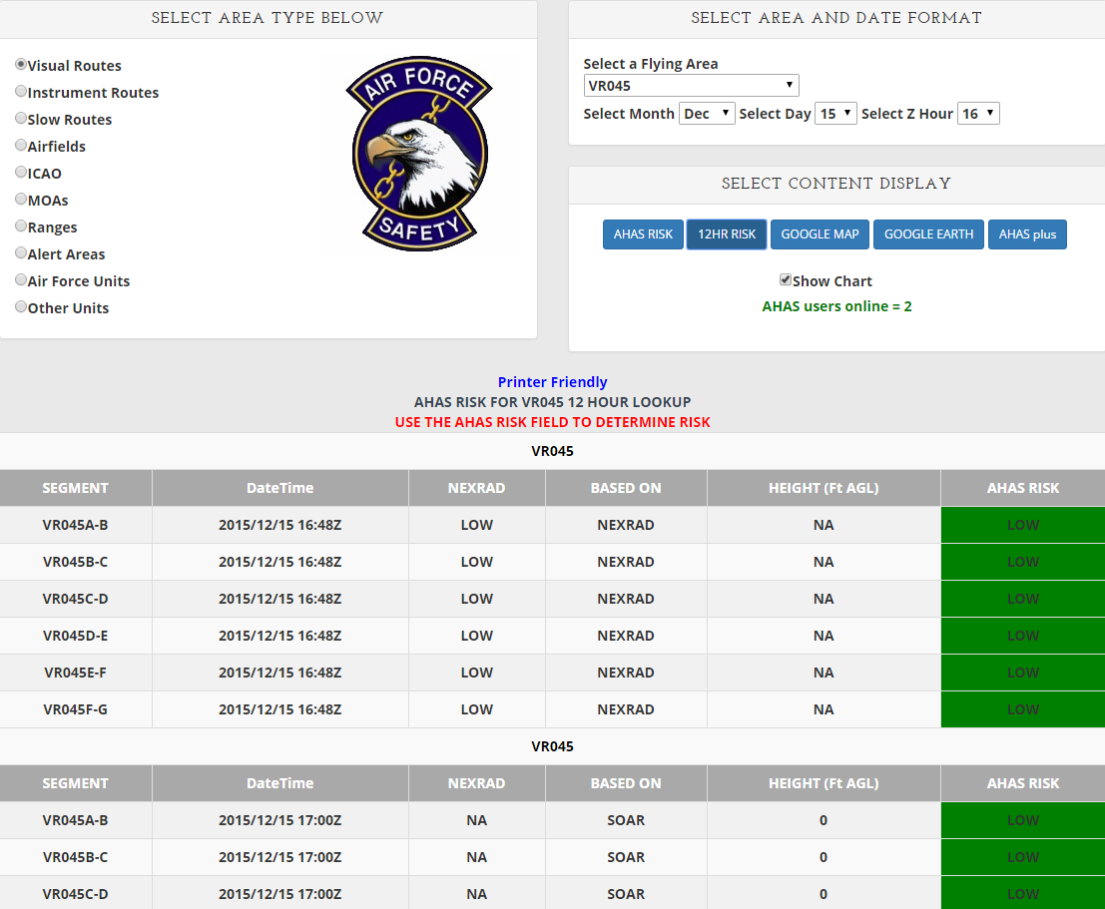
12 HOUR TABLE OUTPUT
1
2
3
Search Criteria: VR 045 (1, 2), hour in Zulu (3), output choice, 12HR RISK (4)
AHAS indicates the driving model (5) for the overall risk (6), color coded
NEXRAD risk is only available for the current hour
12 hours of risk will be shown starting at the selected hour
Scroll down for more hours
No hazards or alternate routes are shown on the 12 hour web page
Expect longer download times for expanded data
4
5
6
6
Copyright 2022, DeTect, Inc, All Rights Reserved

Slide 10
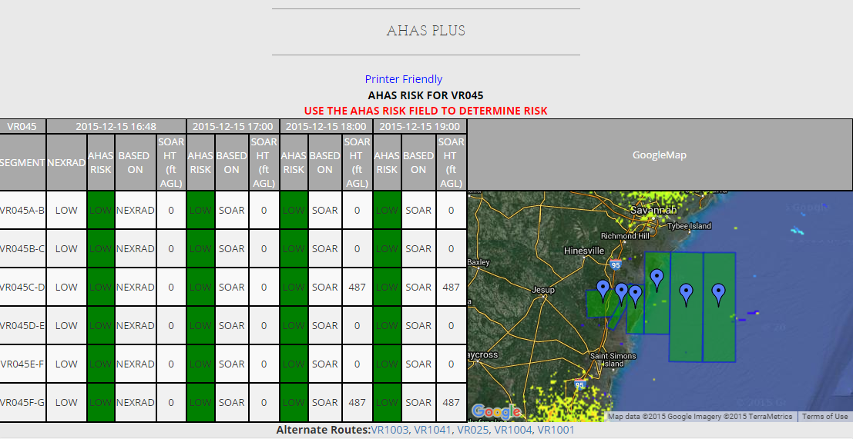
AHAS PLUS
Selected hour information
NEXRAD RISK, AHAS RISK, BASED ON, SOAR HT.
AHAS plus table opens in a new window
Hazards and alternate routes will still display (not shown)
Displays selected hour and the next 3 hours
NEXRAD risk is only available for the current hour
Shows driving model and overall risk (color coded) for all 4 hours
Shows selected area and NEXRAD data in Google Map display
Next 3 hours
6
Copyright 2022, DeTect, Inc, All Rights Reserved

Slide 11
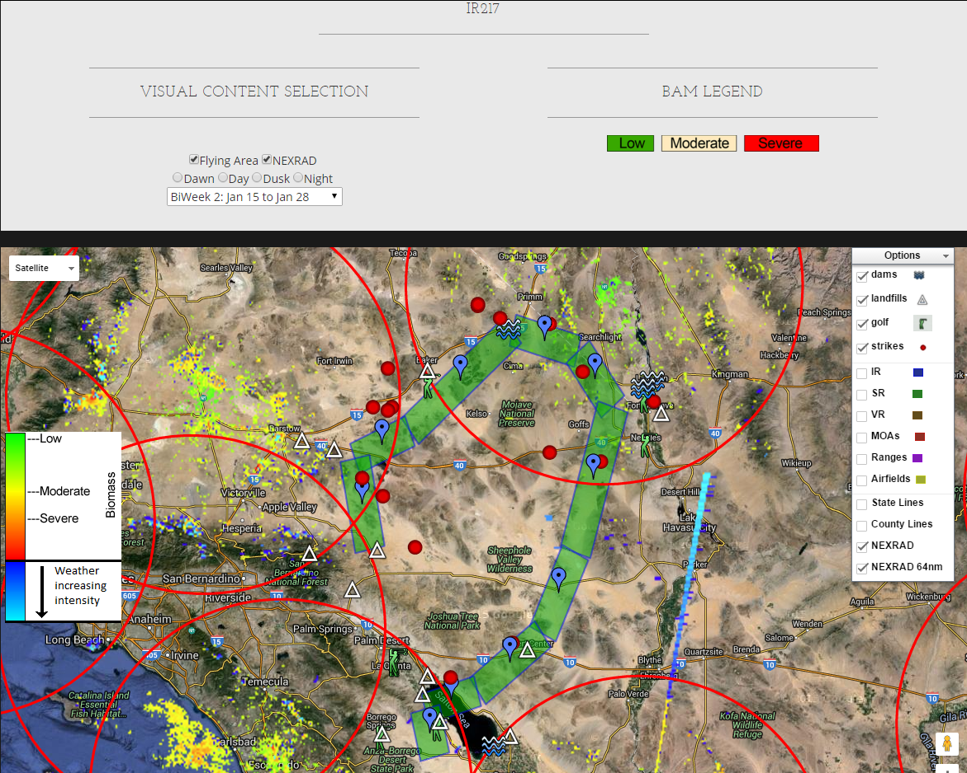
MAP OUTPUT
Search Criteria: IR217, route color based on current risk. Automatically updates every 6 minutes (1).
Google Map is available for unit- specific pages, but they may be very slow depending on the number of areas.
Standard Google Map features include pan, zoom and map view or satellite view(2).
Select different BAM bi-weeks and periods (3).
May add different map options (4).
3
2
4
1
1
6
Copyright 2022, DeTect, Inc, All Rights Reserved

Slide 12
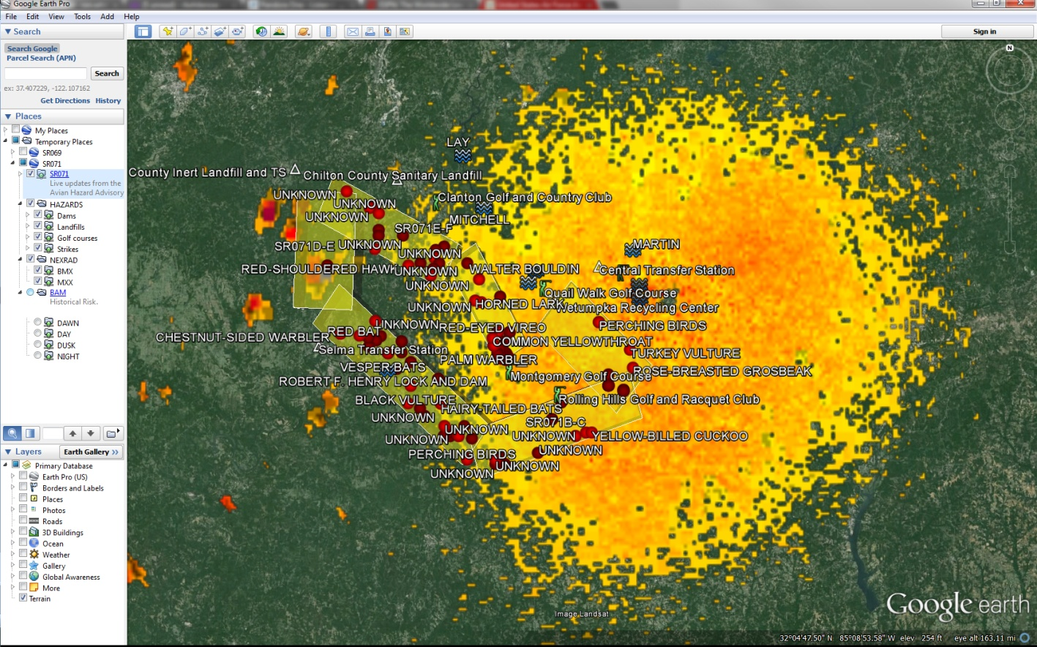
GOOGLE EARTH OUTPUT
Search Criteria: SR 071, current hour
Risk matches table results and auto updates every 6-10 minutes
Hazards can be turned on or off, ON in this image (1)
BAM layers can be turned on or off, OFF in this image (2)
Route segment color defines warning level
Green = Low
Yellow = Moderate
Red = Severe
1
2
6
Copyright 2022, DeTect, Inc, All Rights Reserved

Slide 13
RISK DETERMINATION
The AHAS risk is determined based on the highest risk between the soaring model and the NEXRAD risk
If both the NEXRAD risk and the soaring data are not available, the AHAS risk will be based on the BAM
  If the NEXAD risk is missing the risk will be based on the highest risk between the soaring model and the BAM.
  If the soaring data is missing and the NEXRAD risk is LOW, the AHAS risk will be based on the BAM
Missing NEXRAD data will be indicated on the web page as “NO DATA” in the NEXRAD column
Missing soaring data will be indicated on the web page as “NO DATA” in the Height column
4
Copyright 2022, DeTect, Inc, All Rights Reserved

Slide 14
CURRENT HOUR QUERY
Current Condition Query
  Uses NEXRAD weather radar system (updated every 6-10 minutes) to monitor large-scale migratory bird activity in the CONUS and Alaska
  Includes risk from soaring bird activity
  Risk displayed defaults to the most severe prediction model (NEXRAD or Soaring)
    Displayed thermal depth height offers maximum altitude and below where conditions are optimal for hazardous soaring birds to be present
    May use BAM data if either the NEXRAD or soaring risk is missing
  “Based On” field indicates primary source of risk
4
Copyright 2022, DeTect, Inc, All Rights Reserved

Slide 15
CURRENT HOUR - NEXRAD
Operational Risk Management
AHAS uses two factors to calculate NEXRAD risk: “Severity” is based on the dBZ (decibels of Z, where Z represents the energy reflected back to the radar) and “Probability” of a bird strike (percentage of area polygon filled with biological activity)
AHAS calculates NEXRAD risk by multiplying Severity and Probability to get a value in the below table (Green = Low, Yellow = Moderate, and Red = Severe)
Any value <= 300 is low risk and > 4000 is severe risk
 | Probability
Severity (z) | 20 | 40 | 60 | 80 | 100
3 | 60 | 120 | 180 | 240 | 300
10 | 200 | 400 | 600 | 800 | 1000
30 | 600 | 1200 | 1800 | 2400 | 3000
100 | 2000 | 4000 | 6000 | 8000 | 10000
300 | 6000 | 12000 | 18000 | 24000 | 30000
9
Copyright 2022, DeTect, Inc, All Rights Reserved

Slide 16
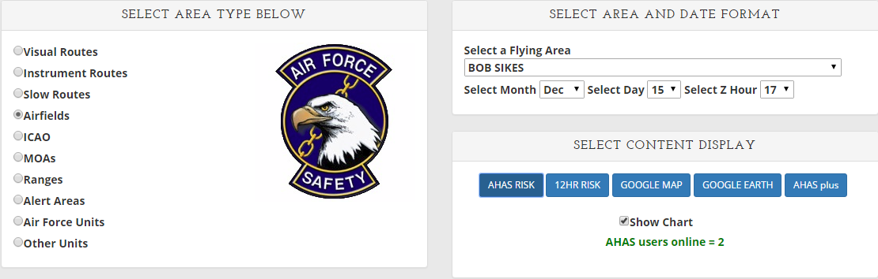
CURRENT HOUR QUERY
Query Example – Bob Sikes
Go to www.usahas.com
Click desired area (1, Airfields)
Select Bob Sikes(2), current hour in Zulu (3), and output format (4)
Note: Airfield Category predicts conditions above and in a 5 nautical mile radius around the airfields and not on the fields themselves
Actual airfield conditions should be determined by observed conditions and relayed through BWC
2
3
1
4
9
Copyright 2022, DeTect, Inc, All Rights Reserved

Slide 17
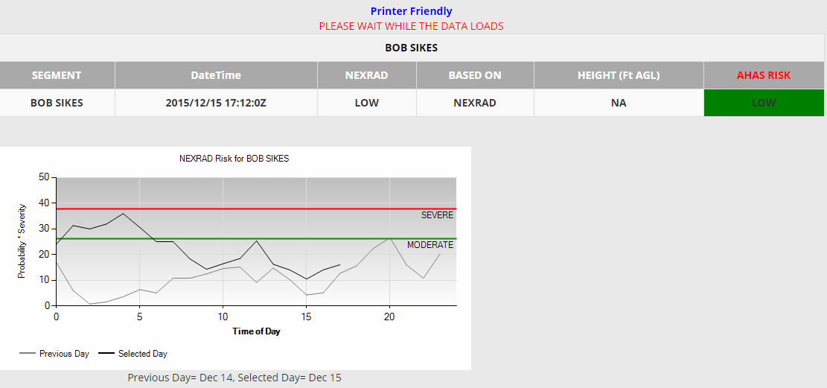
CURRENT HOUR QUERY
NEXRAD column shows the current NEXRAD risk. “NO DATA” indicates that the radar is down or the selected hour is not current
Based On column indicates which model/input is driving the risk reading; in this case, NEXRAD Model
Overall AHAS risk driven by highest risk model. NEXRAD model overrides any ties. Cell is color coded based on risk
Height column shows the max altitude (AGL) where soaring birds might be present. In this case, “NA” indicates that the risk is not based on the soaring model. “NO DATA” indicates that the soaring data is missing
The chart shows the previous days NEXRAD risk compared to today’s risk.
6
Copyright 2022, DeTect, Inc, All Rights Reserved

Slide 18
FORECAST QUERY
(>1 and up to 24 hours)
Forecast Conditions Query
  NWS weather observations and forecast model data predict soaring bird activity in the contiguous 48 states and Alaska
  Soaring models are run twice a day, at 0600 and 1800 to forecast bird strike risk up to 24 hours in advance
  The Soaring Bird Forecast Model predicts likelihood of soaring birds based on calculating thermal depth and US BAM data
    Displayed thermal depth height indicates where conditions are right for soaring birds to be present
4
Copyright 2022, DeTect, Inc, All Rights Reserved

Slide 19
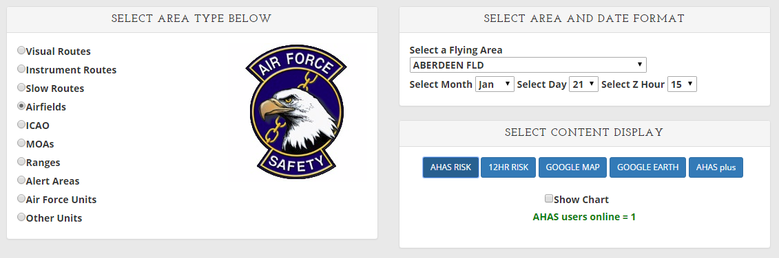
FORECAST QUERY
(>1 and up to 24 hours)
Query Example – Aberdeen Fld
  Go to www.usahas.com
  Click desired area (Airfields)
  Select Aberdeen Fld, desired time, and select output format
  Everything is the same as a current hour query except you select a time between 1 and 24 hrs from current time
Next hour selected
4
Copyright 2022, DeTect, Inc, All Rights Reserved

Slide 20
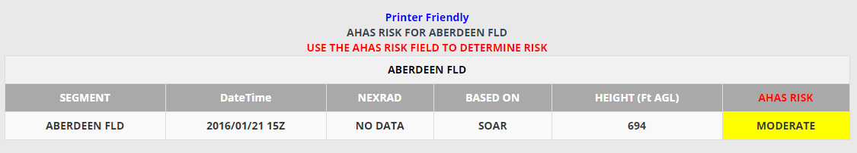
FORECAST QUERY
(>1 and up to 24 hours)
Outside of 1 hour NEXRAD data is not available
Based On column indicates which model/input is driving the risk reading; in this case, SOAR
Query is from between 1 and 24 hours of the current time
Height column shows the max altitude (AGL) where soaring birds might be present. In this case, “694” indicates that conditions are right for soaring birds to be present up to 694’ AGL and below
4
Copyright 2022, DeTect, Inc, All Rights Reserved

Slide 21
HISTORICAL QUERY
(24 hours or past)
  AHAS risk prediction reverts to the BAM if:
    Query is for a time prior to the current month
    Query is for time period >24 hrs in advance of the current hour
    Other data sources are unavailable
  Past data for the current month is now available on the web page
  Past data older than the current month can be requested from the USAF BASH Team
4
Copyright 2022, DeTect, Inc, All Rights Reserved

Slide 22
HISTORICAL QUERY
(24 hours or past)
  Bird Avoidance Model (BAM) data is based on:
  All bird species present during a particular daily time period, in a particular area, for one of 26 two-week periods in a year
  Geographic information for observations of 60 key BASH species, over a 30-year period
  Several key datasets, including the Audubon Society’s Christmas Bird Count (CBC), the US Biological Survey's Breeding Bird Survey (BBS), bird refuge arrival and departure data for the conterminous US, and data specific to a particular bird species
  Common behavior of species groups modeled for dawn, day, dusk, and night
4
Copyright 2022, DeTect, Inc, All Rights Reserved

Slide 23
RISK SUMMARY
  The NEXRAD risk only applies to the current hour. The NEXRAD data shows the bird activity within the last 6 minutes. So that is the most accurate data. There is no way for the NEXRAD data to project what might be happening any time in the future.
  NEXRAD data is designed to remove static targets. That's why it doesn't
  show mountains and buildings, etc. Soaring birds are static targets when
  they are riding thermals. The soaring model was added to cover that
  weakness in the NEXRAD data. So even in the current hour, if the soaring risk is higher than the NEXRAD risk, the soaring risk takes precedence.
  If the current risk for any area is low based on NEXRAD, that also means that the soaring risk is low. The BAM will only be used in the current hour if the NEXRAD data is missing. If the NEXRAD data is missing, AHAS will use the highest risk between the soaring risk and BAM risk. Or if the soaring risk is missing, the NEXRAD is low and the BAM is greater than low.
  For any hour beyond the current hour, the AHAS risk will be based on the highest risk between the soaring model and the BAM.
  You cannot look at hours that have passed, beyond the current month. When you look a time period that has already passed, you are really looking at that time period next year and all you will get is the BAM risk.
  The chart can show the trend of the NEXRAD risk based on the NEXRAD risk from the previous day.
4
Copyright 2022, DeTect, Inc, All Rights Reserved

Slide 24
COMMON MISUNDERSTANDINGS
  Misperception: historical data from AHAS contains forecasted or current hour data
    It does as long as it is the current month
    Requested historical data prior to the current month is from the US BAM only
  Using AHAS to determine Bird Watch Condition code
    NEXRAD cannot see the lowest airspace\surfaces of the airfield so cannot substitute for on airfield observations of Bird Watch Conditions, it can see the higher altitude movements that are missed at the surface and can add to the bird watch condition, but it cannot evaluate the unseen conditions at the surface
  Expecting NEXRAD data for forecasted and historical queries
    NEXRAD is updated every 6-10 minutes for current hour queries only and can not be forecasted or give historical data at this time
4
Copyright 2022, DeTect, Inc, All Rights Reserved

Slide 25
BEST PRACTICE
  Use BAM data when acquiring route times
    Adjust/modify routes based on AHAS forecasts
  Use BAM in conjunction with AHAS during planning
    Pinpoint wildlife attractants along route of flight
    Identify NEXRAD coverage areas or nearest radar to route
  Access AHAS just prior to step time
  Incorporate ops procedures in local BASH plan
    Call SOF/Sqdn Ops to get current AHAS reading prior to base departure, low-level segments, or when approaching airfield/training area
  Utilize Unit Specific AHAS Web Pages
4
Copyright 2022, DeTect, Inc, All Rights Reserved

Slide 26
BEST PRACTICE
  (Unit web pages)
  Unit Web Pages can include:
    Transition bases
    Flight routes
    Ops and Range Areas
    Specific data impacting mission
  Unit Web Pages are ideal for:
    Operations Supervisors
    SOFs
    Crews stepping to fly
  Unit Web Pages can be tailored to suit user’s needs
  Hazards do not display on unit web pages
4
Copyright 2022, DeTect, Inc, All Rights Reserved

Slide 27
USAF BASH Team
Mr. Dan Sullivan, Branch Chief : daniel.sullivan.26@us.af.mil, DSN 246-5674
Kyle Russell, Deputy Chief : kyle.russell.17@us.af.mil, DSN 246-5674
Capt. Boss, Wildlife Ecologist : patrick.boss.1@us.af.mil, DSN 246-5848
Commercial prefix : (505) 846-xxxx
AHAS Personnel
Mr. Ron White : ahas@detect-inc.com
Florida : California : Hawaii : Calgary : London : Bejing
www.detect-inc.com www.dronewatcher.com
Copyright 2022, DeTect, Inc, All Rights Reserved

Slide 28
Thank you
United States
DeTect, Inc
2817 Hwy 77,
Panama City,
Florida 32405
USA
contact@detect-inc.com
Canada
DeTect Canada International Inc.
#7 – 503 Hurricane Drive
Calgary, Alberta,
T3Z-3S8
Canada
detectca@detect-inc.com
Europe
DeTect Global, Ltd
Afron House
Worthing Road, Horsham,
Sussex, RH 12 1TL
England
detecteu@detect-inc.com
China
DeTect China
818 West 3 Building, 18 Jian Guo New Ave, Dong Cheng District,
Beijing, 100005
China
detectcn@detect-inc.com
Florida : California : Hawaii : Calgary : London : Bejing
www.detect-inc.com www.dronewatcher.com
Copyright 2021, DeTect, Inc, All Rights Reserved

